Slide 1
Introduction to Programming with Python
Vineet Bansal
Research Software Engineer, Center for Statistics & Machine Learning
vineetb@princeton.edu
August 20-24, 2018

Slide 2
Lists
A collection of ordered stuff (Array)
>>> l = [1, ‘two’, 3.14, 4]
>>> len(l)
4
Indexing/Slicing works the same way as with strings:
>> l[0:2]
[1, ‘two’]

Slide 3
Lists
Test for membership (in keyword) :
>>> 1 in l
True
>>> ‘three’ in l
False
in also works for strings:
>>> s = ‘Hello World’
>>> ‘h’ in s
False
>>> ‘H’ in s
True

Slide 4
Lists
Lists are mutable.
>>> l[2] = 3.0
>>> l
[1, ‘two’, 3.0, 0]
Notice that the id of l does not change.

Slide 5
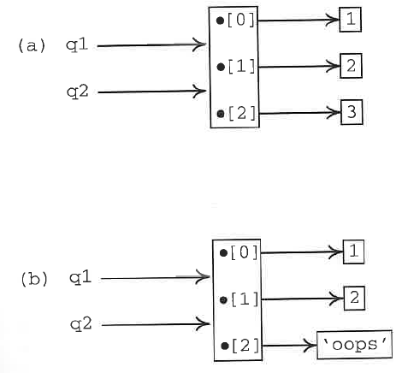
Lists
>>> q1 = [1, 2, 3]
>>> q2 = q1
>>> q1[2] = ‘oops’
>>> q1
[1, 2, ‘oops’
>>> q2
[1, 2, ‘oops’]

Slide 6
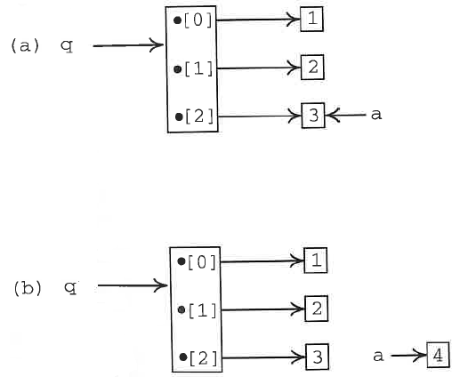
Lists
>>> a = 3
>>> q = [1, 2, a]
>>> a = 4
>>> q
[1, 2, 3]
>>> a
4

Slide 7
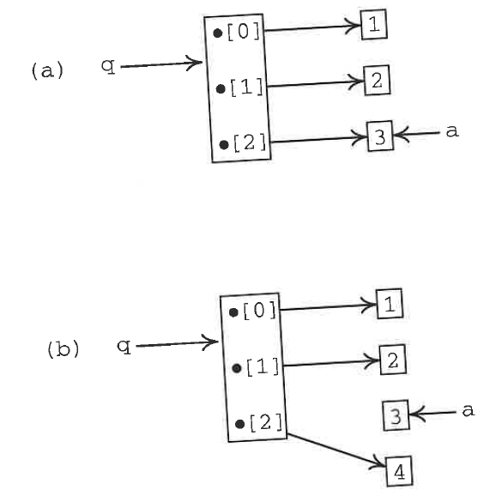
Lists
>>> a = 3
>>> q = [1, 2, a]
>>> q[2] = 4
>>> q
[1, 2, 4]
>>> a
3

Slide 8
Common List Methods
append, extend, index, insert, reverse, sort
Used often!
Work in-place
How do we know which operations work in-place and which operations return a new string/list?
In general, mutable objects can be modified in place, so Python does so. But it doesn’t have to, so just try it and see.

Slide 9
Making a copy of a List
>>> list1 = [1, 2, 3]
>>> list2 = list1
>>> list1 is list2
True
>>> list2 = list1.copy()
>>> list1 is list2
False
>>> list2 = list1[:]
>>> list1 is list2
False
You’ll see this a lot in real programs.

Slide 10
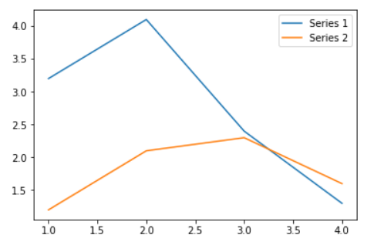
Interlude: Plotting in Notebooks
Now that we know how to create lists of numbers, let’s see how we can plot them in a Jupyter Notebook.
Let’s head over to the Jupyter Notebook..

Slide 11
Iterables
Some built-in functions (len, sum, max, min, any, all, sorted) seem to work on strings/lists/tuples:
>>> max(‘Hello’)
‘o’
>>> max([3,4,1,2])
4
>>> max((3,4,1,2))
4
Is there something common across a string/list/tuple?
All of them are collections of stuff – and can give us things ‘one at a time’, i.e. they are iterable

Slide 12
for loops
Objects that are iterable can be looped over, giving us one item at a time, using a for loop:
for x in <iterable>:
<do_something>
<do_something>
In each iteration of the loop, a new item from <iterable> is put into x
Colon
Body of the loop (x keeps changing value)
Move code over (indent) to specify what you want done inside the loop

Slide 13
for loops
We’ll talk in terms of a list to keep things clear.
>>> names = [‘Homer’, ‘Marge’, ‘Lisa’, ‘Bart’, ‘Maggie’]
>>> for name in names:
... print(name)
...
Homer
Marge
Lisa
Bart
Maggie
Mnemonic Naming!

Slide 14
for loops
Use a loop to sum up a list of numbers.
l = [6, 4, 1, 2, 3, 0]
total = 0
for n in l:
total += n
print(total)

Slide 15
A note on indentation
An indented block of code tells Python when the loop ends.
total_salary = 0
for salary in salaries:
print(‘Salary = ‘, salary)
total_salary = total_salary + salary
print(‘Total Salary = ‘, total_salary)
Python doesn’t care if you use spaces or tabs, but by convention, use 4 spaces for an indent (most Python editors will convert tabs to spaces).
Don’t mix tabs/spaces within a block (illegal), or within your program (sloppy).

Slide 16
The range type
We often need to refer to a sequence of consecutive numbers. For example:
Sum up the series (1+2+3+..+99)
range(N) = 0, 1, 2, .. N-1
>>> range(10)
range(0, 10)
>>> list(range(10))
[0,1,2,3,4,5,6,7,8,9]

Slide 17
for loops
Exercises 1, 2

Slide 18
Control Flow – if/else
Few computer programs are executed in a purely linear fashion. Blocks of code are usually executed conditionally on the basis of some test carried out on data.
if <logical expression 1>:
<statements 1>
elif <logical expression 2>:
<statements 2>
...
else:
<statements>

Slide 19
Control Flow – if/else
Few computer programs are executed in a purely linear fashion. Blocks of code are usually executed conditionally on the basis of some test carried out on data.
for x in range(10):
if x <= 3:
print(x, ‘is less than or equal to 3’)
elif x > 5:
print(x, ‘is greater than 5’)
else:
print(x, ‘must be four of five, then’)

Slide 20
Control Flow – if/else
Exercises 3, 4

Slide 21
while loops
Whereas a for loop is established for a fixed number of iterations, statements within the block of a while loop execute only and as long as some condition holds.
>>> i = 0
>>> while i < 10:
... i += 1
... print(i, end=‘.’)
>>> print()
1.2.3.4.5.6.7.8.9.10

Slide 22
break/continue
Use break to immediately end the loop.
Find the first negative number in a list of numbers:
alist = [0, 4, 5, -2, 5, 10]
for a in alist:
if a<0:
break
print(a)

Slide 23
break/continue
The continue statement acts in a similar way to break but instead of breaking out of the containing loop, it immediately forces the next iteration of the loop.
Print only even integers in a given range.
N = 100
for i in range(1, N+1):
if i%2:
continue
print(i, ‘is even’)

Slide 24
while loops
Exercise
Do this exercise in the terminal rather than the jupyter notebook (jupyter notebook is not particularly good at getting user input!)
Write a Python program that asks the user to respond by ‘y’ or 'yes’ (case doesn’t matter). The program keeps on asking until the user enters the correct information. (Use the ‘input’ function to get a response from the user).

Slide 25
File input/output
Mode | Meaning
'r' | open for reading (default)
'w' | open for writing, truncating the file first
'x' | open for exclusive creation, failing if the file already exists
'a' | open for writing, appending to the end of the file if it exists
'b' | binary mode
't' | text mode (default)
'+' | open a disk file for updating (reading and writing)
A File object is created by opening a file with a given filename and mode.
f = open(‘myfile.txt’, ‘w’)
f.write(‘Hello World’)
f.close()
Python closes any File objects automatically when a program terminates.

Slide 26
Reading from a file
readline() reads a single line from a file, up to and including the newline character. The next call to readline() reads the next line. It returns an empty string when it reaches the end of the file.
To read all the lines into a list pf strings, use f.readlines()
File objects are iterable too, and looping over a (text) file returns its lines one at a time.

Slide 27
Reading from a file
Exercises 5, 6

